Slide 1
Slot 13 Programming With Menu
A review for C-Functions
Pointers are parameters of functions
Using some C++ characteristics
Notes:
Prepared by Thân Văn Sử

Slide 2
Why is Menu?
Generally, a program performs some operations and at a time only one task is carried out. ➔ A menu is usually used.
➔ How are menus implemented in C program?

Slide 3
Idea
Common Algorithm in the entry point:
int userChoice;
do
{ userChoice= getUserChoice();
switch (userChoice)
{ case 1: function1(); break;
case 2: function2(); break;
case 3: function3(); break;
}
}
while (userChoice >0 && userChoice<maxChoice);

Slide 4
Problem
Write a C program using the following menu:
1- Operation 1
2- Operation 2
Others- Quit
If user chooses 1, user will input 2 integers, the program will print out sum of integers between them including them.
If user chooses 2, user will input 2 characters, the program will print out the ASCII table between two inputted characters in ascending order.
If user chooses other options, the program will terminate.

Slide 5
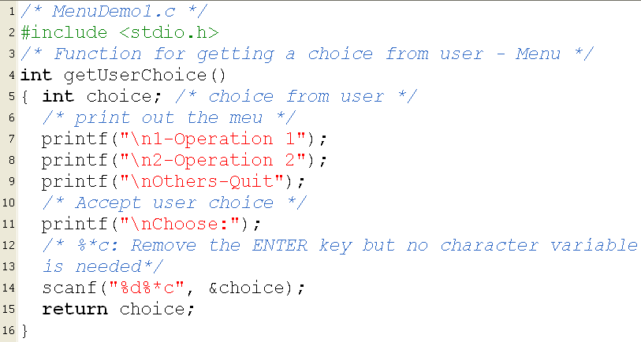
Implementation: menuDemo1.c

Slide 6
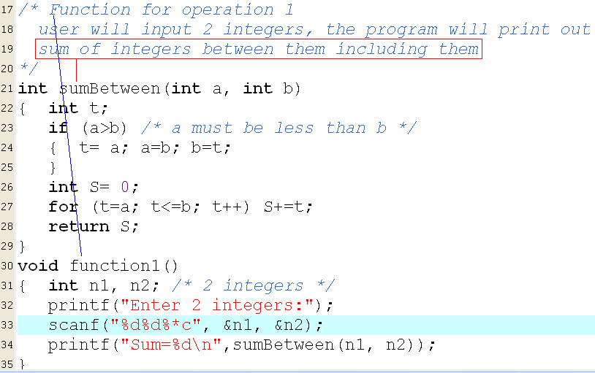

Implementation: menuDemo1.c

Slide 7
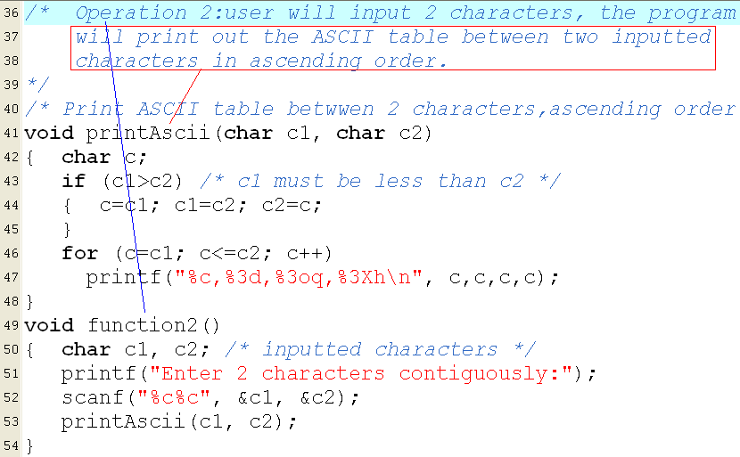
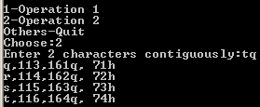
Implementation: menuDemo1.c

Slide 8
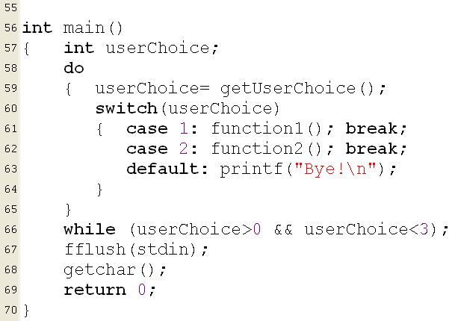
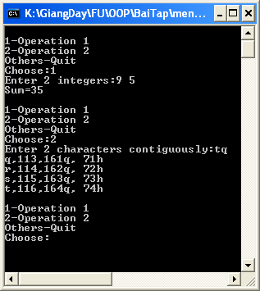
Implementation: menuDemo1.c

Slide 9
Functions with pointers as parameters
C uses by-value parameters only → A function can not modify values of arguments.
To modify values of arguments, pointers as parameters of a function are used.

Slide 10
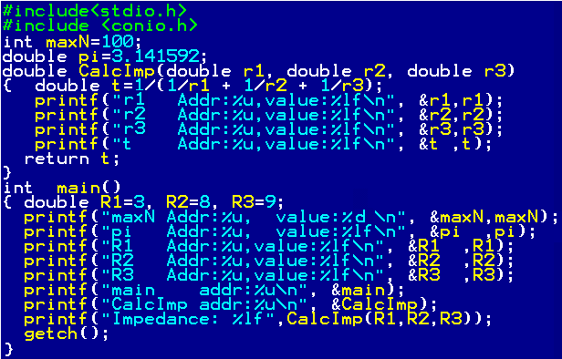
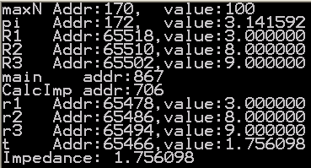
Functions with pointers as parameters
Review: Pass by-value Parameters
65518
R1=3
stack
segment
65510
R2=8
X
65502
R3=9
65494
r3=9
65486
r2=8
65478
r1=3
65466
t=1.75…
Heap
main
code
code
segment
867
CalcImp
code
706
172
pi=3.14..
Data
segment
170
maxN=100

Slide 11
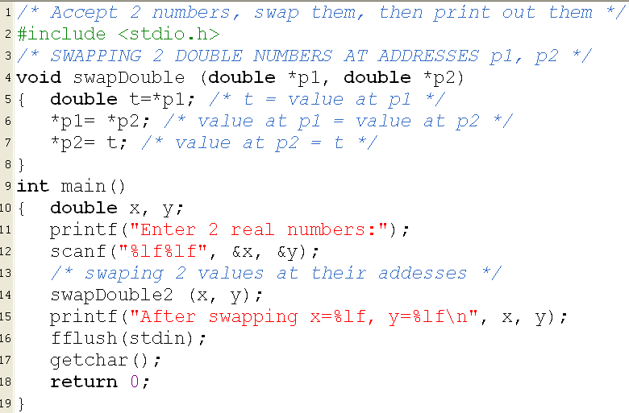
Pointers as parameters: Demo
1000
x=9.08
main
y=-12.34
992
p1: 1000
swapDouble
p2: 992
t
swapDouble(&x, &y);

Slide 12
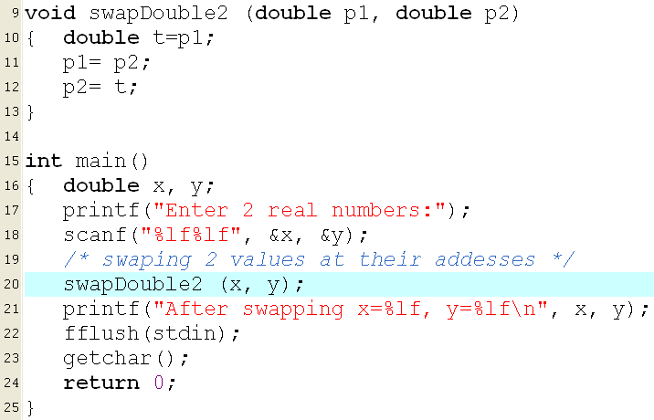

Pointers as parameters: Demo
1000
x=9.08
main
y=-12.34
992
p1: 9.08
swapDouble2
p2: -12.34
t

Slide 13
Introduction to C++
C++ is an Object-Oriented Language
It is developed from the C language and the language C is contained in C++ language
The programming tool Dev-C++ supports both C and C++ source codes
File extension of a C++ source code is .cpp
We can use some C++ characteristics to develop programs more easily, such as:
References in C++ can be used as a replacement of pointers in function parameters
The new and delete operators to allocate/de-allocate dynamic data instead of C functions malloc, calloc, free
Utilities about variable declarations, comments

Slide 14
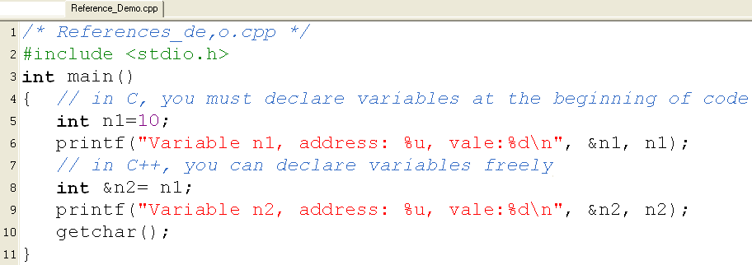

C++: References
A way to give another name of a datum
// Comment to the line end
Both n1 and n2 are stored in only one memory block
→ n2 is the another name of n1

Slide 15
Function Parameters
You want | Use
Code of function can not modify arguments | Passing by value (characteristic of C)
Code of function can modify arguments | Pointers, addresses of arguments cannot be modified but values in it can be modified by the operator ->
 | References of C++, names of arguments are passed to function

Slide 16
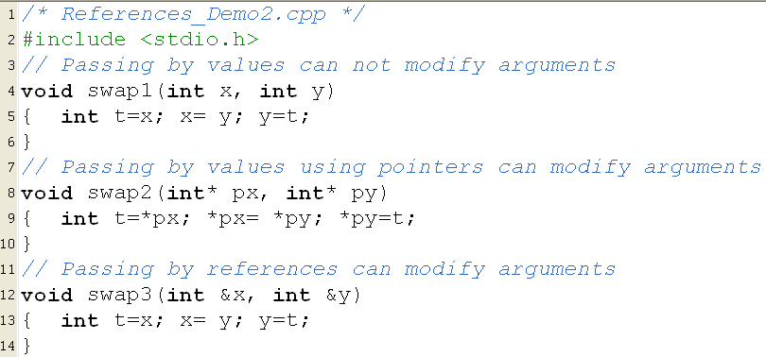

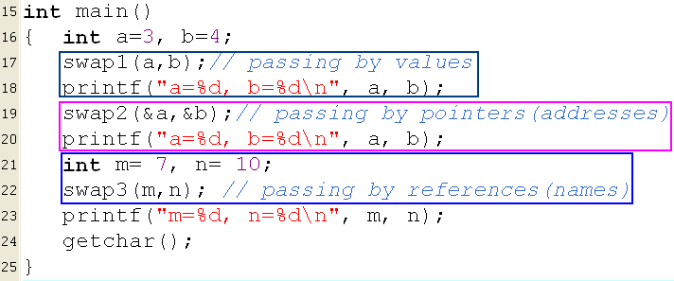
Passing Arguments

Slide 17
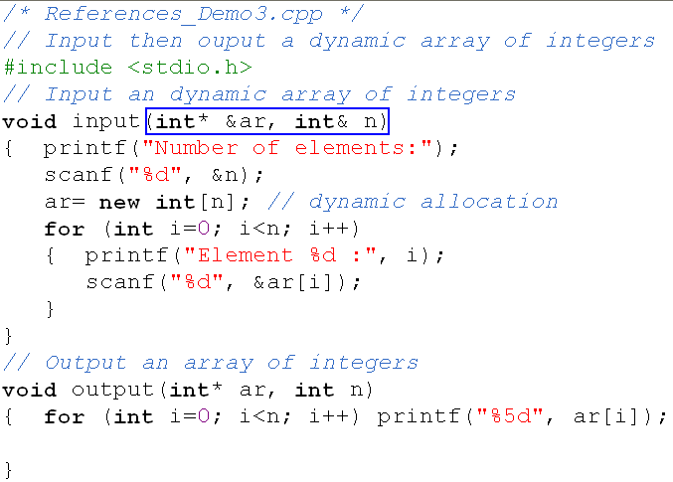
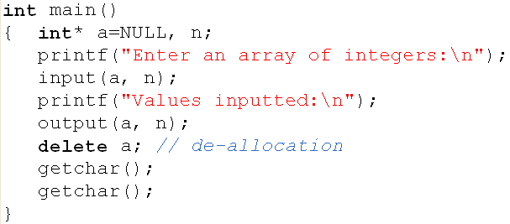
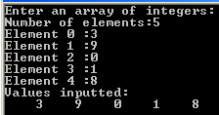
Passing References to Function
You can declare a local variable in the statement for

